Slide 1
GROWING SERVICE
A Toolbox of Opportunities

Slide 2
The Growth Cycle
Service Work Grows
More UA Techs Hired
UA Funds Increase
Training Programs Enhanced
More Skilled HVAC Techs Available
Market share expands
Profits Increase

Slide 3
National Service and Maintenance Agreement
Specific to unique needs of service industry
Provides quality, consistent service to customers throughout country
Respects locally negotiated fringes and benefits
Ensures uninterrupted service – critical for tenant comfort and safety and retention of customer base
Enhances competitiveness of service contractors
Addresses specific local concerns through Schedule A
Provides local oversight

Slide 4
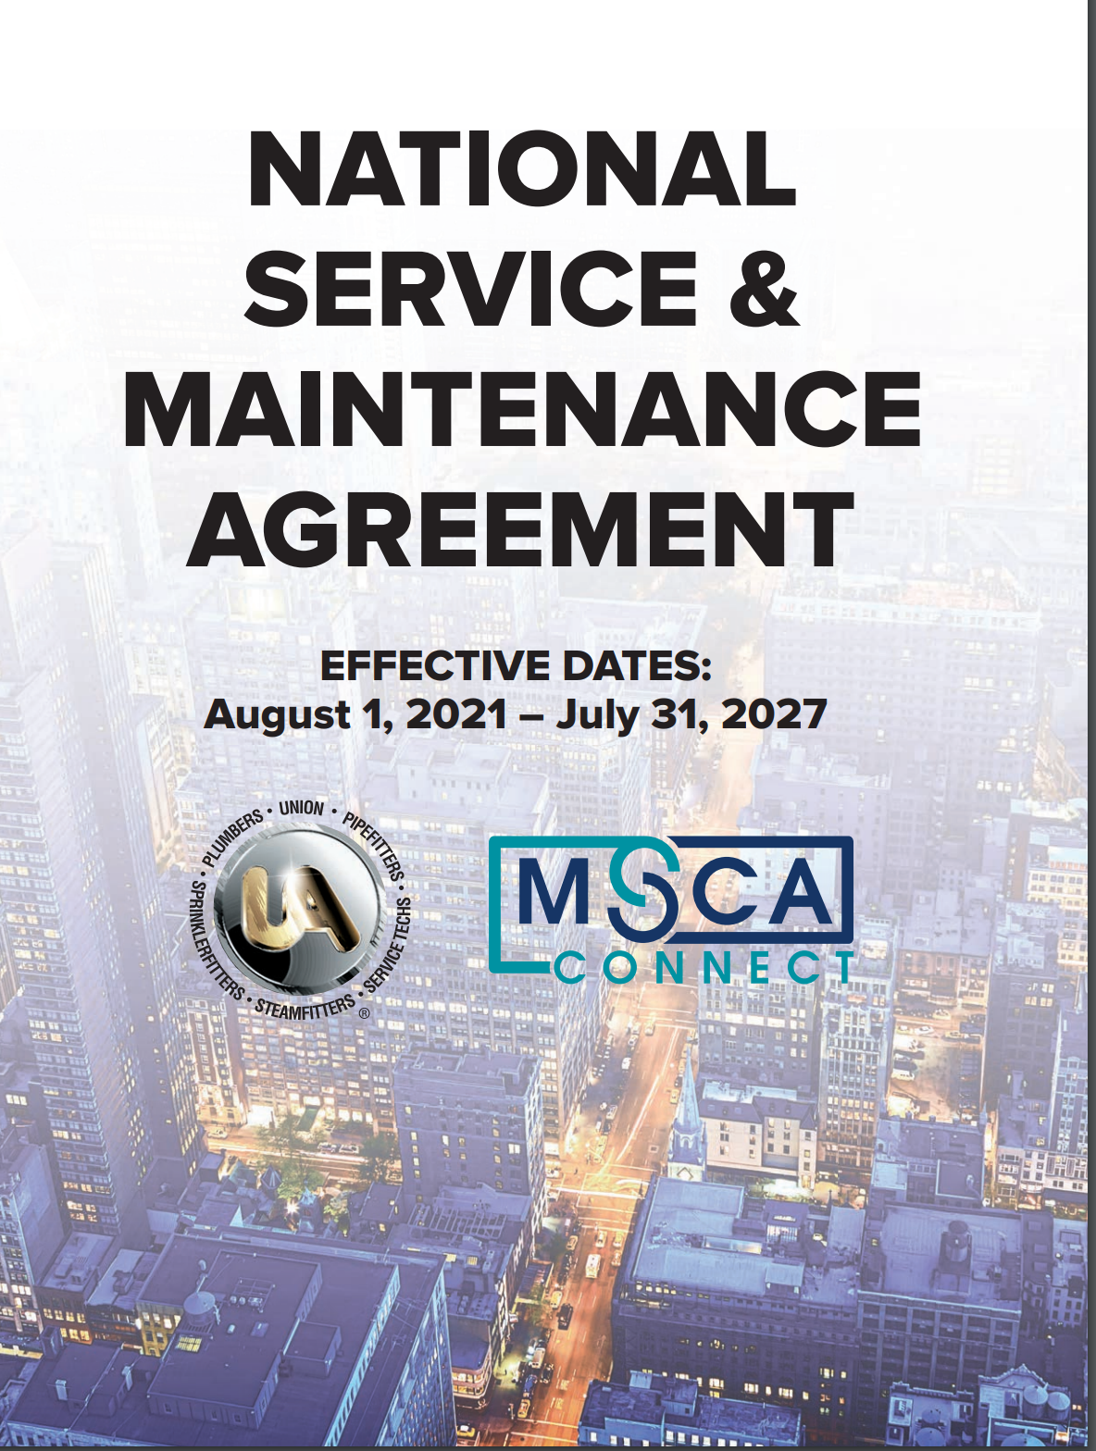
Application Procedures
Send written request to UA or Business Manager
International Rep will follow-up
Agreements sent to contractor for signature
UA notifies MSCA of new signer
MSCA sends membership and payment information
  MSCA membership separate
  Current contribution rate $.09 per labor hour

Slide 5
Relationship to Local Agreement
Not required to sign for any work covered under scope of NSMA
National Agreement and Schedule A prevails
Bound to local wages, fringes and benefits
May be required to sign local trust agreements
All UA local unions must recognize terms and conditions

Slide 6
Scope of Service Work – Paragraph 11
“This Agreement shall apply to and cover all work… to keep existing mechanical, refrigeration and plumbing systems within occupied facilities operating in an efficient manner.”
Includes related piping connections and controls

Slide 7
Other work within UA jurisdiction
All refrigeration new installation and remodel work – per Article XXV
All other work outside scope of Agreement – per local building trades agreement

Slide 8
Classifications of Employees
Service Journeyman
Serviceman
Service Apprentice
Tradesman
Probationary Employee

Slide 9
Service Journeyman
5 years working experience
Performs all work covered by Agreement
May be required to pass UA STAR exam

Slide 10
Serviceman
Implemented to enhance competitiveness and regain lost market share
Commercial & residential work
Includes unitary systems such as rooftops, split systems, packaged units, water-source heat pumps, unit heaters, and furnaces
UA STAR exam for Serviceman
Duties can be modified to meet local conditions

Slide 11
Service Apprentice
Limited only by skill level
Under direction of Serviceman or Service Journeyman
Governed by local JATC

Slide 12
Tradesman
Performs routine maintenance and inspections
Building operations under contract with facility manager
Installation and replacement of residential HVAC and plumbing
2022 addition: solar energy equipment, HVAC power electronics and building controls
Duties can be adjusted to meet local conditions

Slide 13
Probationary Employee
Provides opportunity to evaluate skills/capabilities
Employer sets pay rate/benefits
No fringe contributions to union
Must send written notification to local union when hire
Recruitment opportunities
After six months must terminate or join local union

Slide 14
Home Local Union
Redefined for clarity – esp. relevant for Right-to-Work states
Jurisdiction where Employee’s fringe benefit contributions regularly contributed

Slide 15
Rates of Pay and Fringes
Service Journeyman
► Per local agreement
Serviceman
► Per Schedule A
Service Apprentice
► Per local agreement
Tradesman
► Per Schedule A
Probationary Employee
    ► Determined by Employer

Slide 16
Hiring and Use of Employees
Hiring Procedure (Para. 20 – 22)
  Must submit initial request to local union – indicate any special skills required
  Employer has right to reject
  Union has 48 hours to supply
  Employer can hire “off the street” if no qualified employees available

Slide 17
Start-Up (Para. 26)
  Can use service Employee for start-up of new installations
  Includes testing, adjusting and balancing
  Wages and fringes per local agreement

Slide 18
Hiring and Use of Employees
Working outside local (Para. 27)
  May assign first three Employees from regular workforce
  Next two from jurisdiction where job located
  More than 16 hours/week – notify local
  Higher wage rate after 16 hours/week
  Fringes per Employee’s home local

Slide 19
Hiring and Use of Employees
Working outside local (Para. 29)
  Employees working on a job exceeding 15 consecutive working days:
    All fringes and deductions per local jurisdiction where working
    Payments submitted to local jurisdiction where working
    Fringes reciprocated back to home local

Slide 20
Subcontracting (Para. 32)
Language clarified to promote subcontracting to union contractors
Language added for emergency conditions

Slide 21
Wage, Benefits and Hours of Work
(Article XII)
40 hours/5 days, Monday – Saturday, start time 6:00 a.m. – 10:00 a.m.
Establish “regularly scheduled” hours
Four 10’s
Overtime – NSMA establishes maximums
On-call time – between Employer and Employee

Slide 22
No Strike – No Lockout Clause
Para. 64 - 65
Vital for customer retention
Vital for safety, health and comfort reasons
Applies to all service and refrigeration work as defined in scope
May warrant separate service/construction entrances

Slide 23
Grievance Procedure
Article XIX
Communications key!
Follow procedure as outlined
Respect time limits – grievance can be dismissed if time limits exceeded
Document everything in writing

Slide 24
MSCA Contributions (Article XXII)
No additional contributions if dues-paying member of MSCA/MCAA
Current contribution rate of $.09 per manhour
All work performed under the Agreement/all classifications of Employees
All branches
Minimum of 4,000 hours per year ($360)
Non-payment is grounds for NSMA termination

Slide 25
National Joint UA/ MSCA Labor Committee (Para 89-90)
Oversees Agreement and Schedule A
Interprets and explains provisions of Agreements
Listens to concerns and recommendations nationwide
Supports service training and recruiting
Goal is to grow service industry

Slide 26
Schedule A (Para 72-73)
Recognizes unique local needs
Builds flexibility into Agreement
Can be implemented if local agreement terminates, to include wages
Can be requested by signatory contractor or local union
Negotiated by local oversight committee
Must be approved by Joint UA/MSCA Committee and signed by UA General President and MSCA
Applicable to all NSMA signatory contractors in the Schedule A jurisdiction
Posted on MSCA and UA websites

Slide 27
Oversight Committees (Para 74)
PURPOSE:
► Grow market share
► Local dialogue/communications
► Ensure adequate service training
► Establish joint recruitment program
► Promote value of “energy services”
► Local marketing and promotion
► Ensure Agreement understood
► Recommend Schedule A revisions

Slide 28
Additional Opportunities
Refrigeration Installation Work
  Para. 96 – Initially 3 employees plus Foreman can travel
Plumbing Service
Residential Plumbing Installation
Facility Operations
  Provides facility owners contracted in-house operations and maintenance
  Site Specific
  Allows multiple classifications of workers to fit skill level required
  Wages/Benefits included

Slide 29
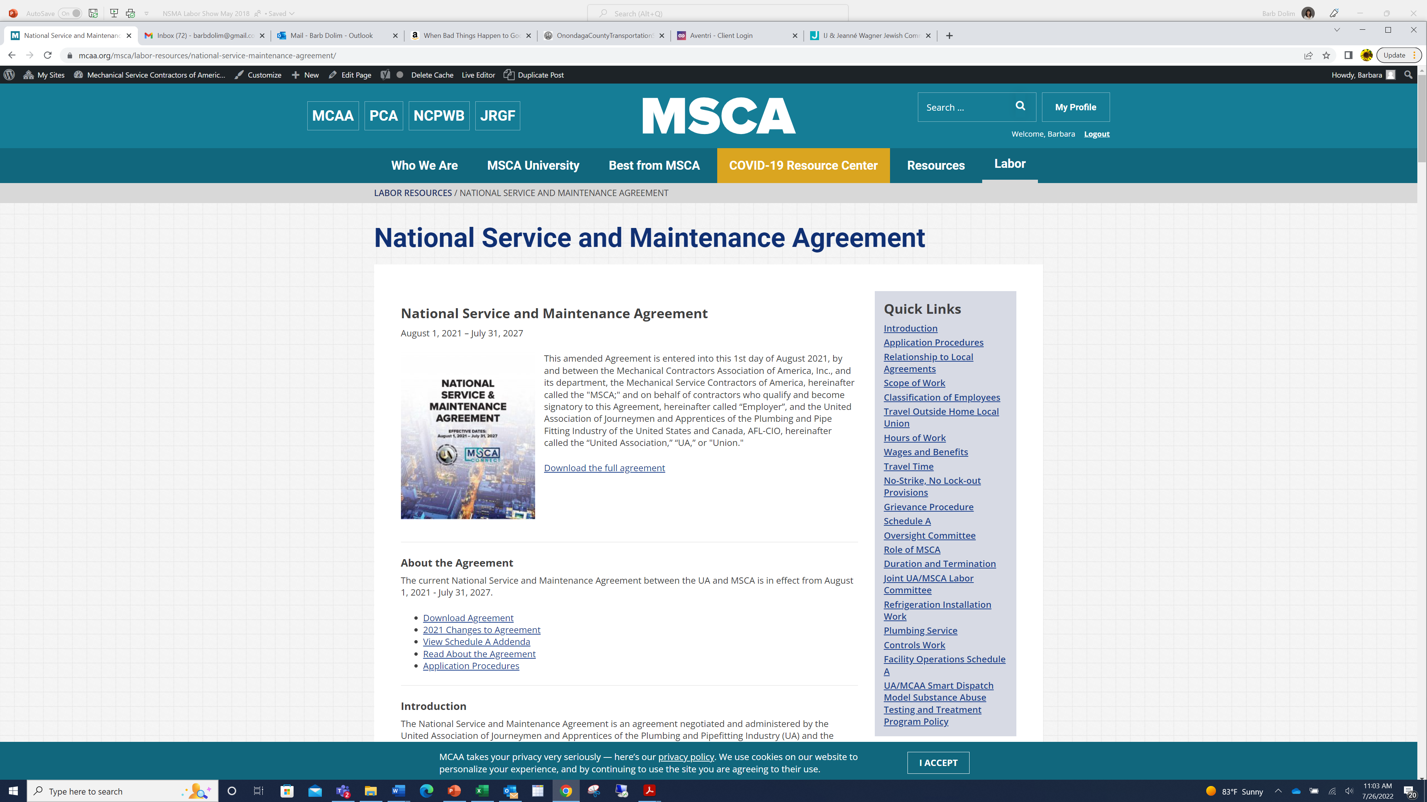
MSCA Website – Labor Tab

Slide 30
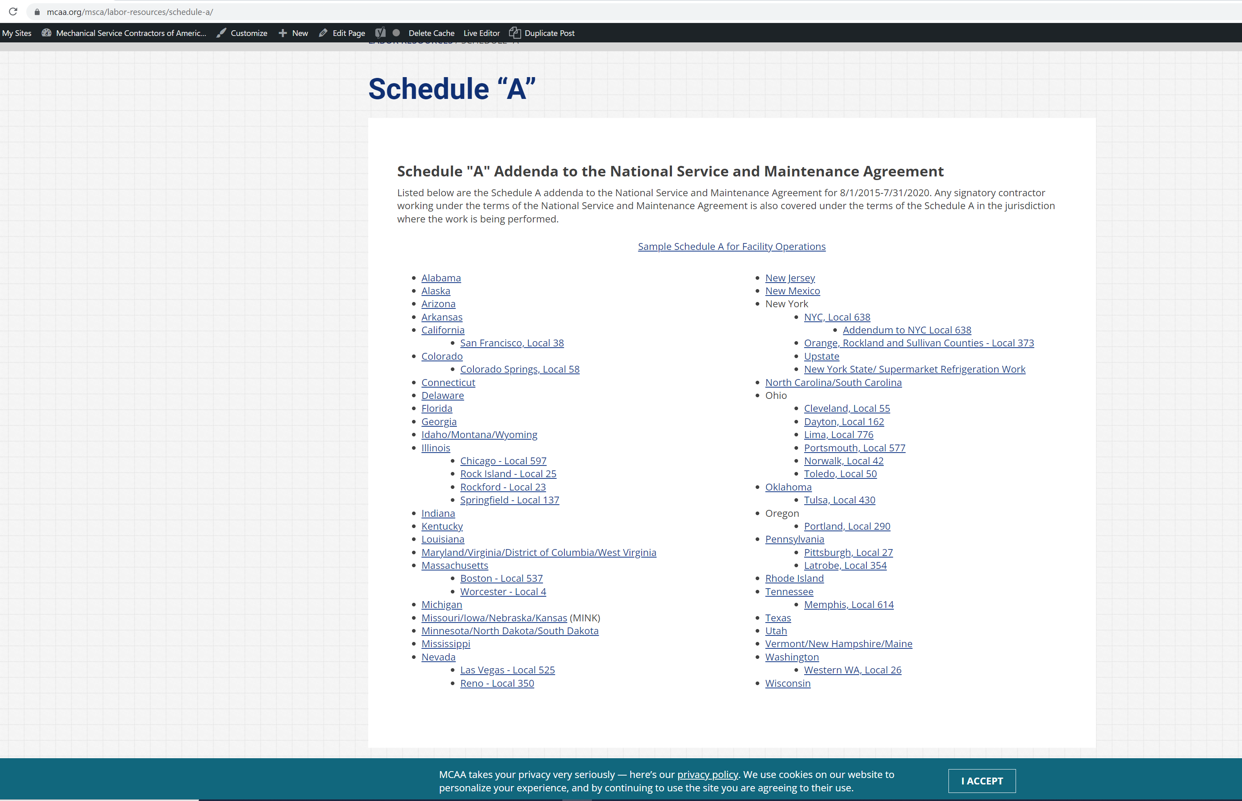

Slide 31


www.msca.org
For further information contact:
  Russ Borst, MSCA Labor Chairman, Russ@hurstind.com
  Brian Kelly, UA Director HVAC Service, bkelly@uanet.org

